Slide 1
Outline
n Importance of Project Quality Management
n What is Project Quality Management?
n Three Main Processes
1. Planning Quality Management
2. Managing Quality
3. Controlling Quality
n Tools and Techniques for Quality Control
n Modern Quality Management
n Improving IT Project Quality
n Using Software to Assist in Project Quality Management
2

Slide 2



Importance of Project Quality Management
n Is quality a real problem with IT projects?
What if your computer or smartphone crashes a couple of times a month?
What if your favorite smartphone apps (e.g., WhatsApp, WeChat or Alipay) malfunction occasionally?
What if you cannot log in to Blackboard or VPN occasionally?
n Yes, because many aspects of our lives rely on high-quality IT products!
Corporations depend on technology for many business functions
Millions of people rely on technology for entertainment and personal communications
Many IT projects develop mission-critical systems that are used in life-and- death situations, such as navigation systems on aircraft & autonomous cars and computer components built into medical equipment
Financial institutions and their customers rely on high-quality information systems
3

Slide 3
What Went Wrong?
n In 1981, a small timing difference caused by a computer program
change created a 1-in-67 chance that the space shuttle’s five onboard computers would not synchronize. The error caused a launch abort.
n In 1986, two hospital patients died after receiving fatal doses of
radiation from a Therac 25 machine. A software problem caused the machine to ignore calibration data.
n In 2018, CEO Mark Zuckerburg responded to a data break by writing in a Facebook post:
“ We have a responsibility to protect your data, and if we can’t then we don’t
deserve to serve you. I’ve been working to understanding exactly what happened
and how to make sure this doesn’t happen again.”
4

Slide 4


What Is Project Quality Management? (1 of 3)
n Definitions of quality
i. Totality of characteristics of an entity that bear on its ability to satisfy stated or implied needs
ii. The degree to which a set of inherent characteristics fulfils requirements
iii. Conformance to requirements: the project’s processes and products meet written specifications
iv. Fitness for use: the product can be used as it was intended
n Project quality management ensures that the project will satisfy the needs for which it was undertaken
The project team must develop good relationships with key stakeholders, especially the main customer for the project, to understand what quality means to them
The customer ultimately decides if quality is acceptable
5

Slide 5

What Is Project Quality Management? (2 of 3)
n Quality must be on an equal level with project scope, time, and cost
If a project’s stakeholders are not satisfied with the quality of the project management or the resulting products of the project, the project team will need to adjust scope, time, and cost to satisfy the stakeholders
n Three main processes
1. Planning quality management: identify which quality requirements and
standards are relevant to the project and how to satisfy them. Incorporating quality standards into project design is a key part of quality planning.
2. Managing quality: translate the quality management plan into executable quality activities, adhering to the organization’s quality policies.
3. Controlling quality: monitor specific project results to ensure that they are complete, correct, and meet customer expectations. This process is often
associated with the technical tools and techniques of quality management.
6

Slide 6
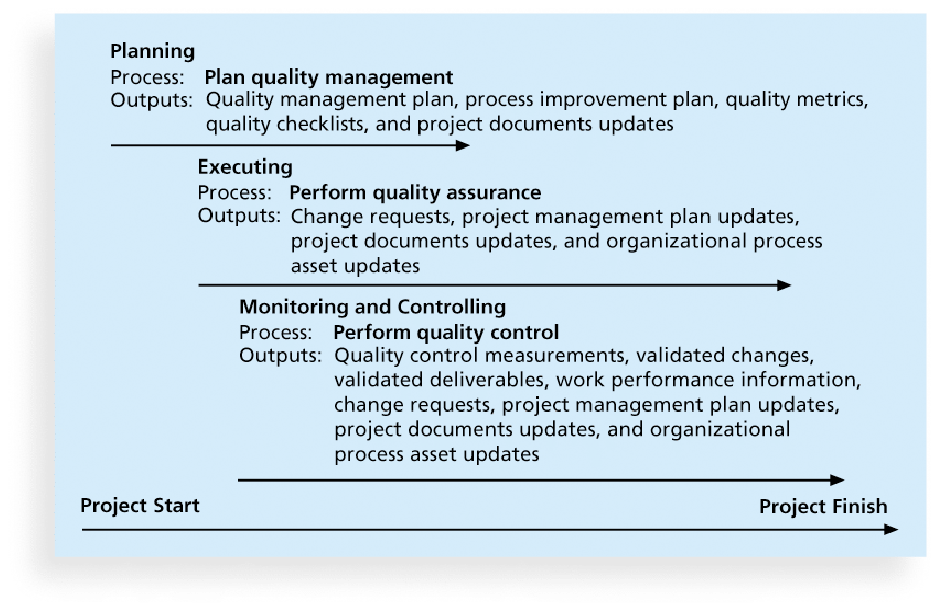
What Is Project Quality Management? (3 of 3)
7

Slide 7


1. Planning Quality Management (1 of 3)
n Planning quality management implies the ability to anticipate situations and prepare actions to bring about the desired outcome
It identifies relevant quality standards for each unique project and designs quality into the products of the project and the processes involved in
managing the project
n Ways for preventing defects
1. Selecting proper materials
2. Training and indoctrinating people in quality
3. Planning a process that ensures the appropriate outcome
n Understanding which variables affect outcome is a very important part of quality planning
Design of experiments is a technique that helps identify which variables have the most influence on the overall outcome of a process
8

Slide 8
1. Planning Quality Management (2 of 3)
n Quality planning also involves communicating the correct actions for ensuring quality in a format that is understandable and complete
Important to describe key factors that directly contribute to meeting the customer’s requirements
n Important scope aspects of IT projects affecting quality
1. Functionality: the degree to which a system performs its intended function
2. Features: the system’s special characteristics that appeal to users
3. System outputs: the screens and reports the system generates
4. Performance: address how well a product or service performs the customer’s intended use
5. Reliability: ability of a product or service to perform as expected under normal conditions
6. Maintainability: address the ease of performing maintenance on a product
9

Slide 9

1. Planning Quality Management (3 of 3)
n Project managers and their teams need to consider all the above project scope issues in determining quality goals for the project
n All project stakeholders must work together to balance the quality, scope, time, and cost dimensions of the project
The main customers must realize their role in 1) defining the most critical
quality needs for the project and 2) constantly communicate these needs and expectations to the project team
Project managers are ultimately responsible for quality management on their projects
n Project managers should be familiar with basic quality terms, standards, and resources
ISO is the source of ISO9000 and more than 22,000 international standards for business, government, and society
IEEE provides many standards related to quality
10

Slide 10

2. Managing Quality (1 of 2)
n Managing quality includes all quality assurance activities plus the product design and process improvements
Quality assurance describes the activities related to satisfying the relevant quality standards for a project
n Many companies have detailed processes in place to make sure that their products and services confirm to various quality requirements
Good companies develop their own best practices and evaluate those of the other organizations to continuously improve the way they do business
Kaizan is the Japanese word for improvement or change for the better. A Kaizan approach has been used in many organizations since the end of
World War II
Lean, another popular term, involves evaluating processes to maximize
customer value while minimizing waste. Kanban is a technique often used in Lean.
11

Slide 11



2. Managing Quality (2 of 2)
n Several tools used in quality planning can also be used in managing quality
Design of experiments can help ensure and improve product quality
Benchmarking generates ideas for quality improvements by comparing
specific project practices or product characteristics to those of other projects or products within or outside the performing organization
n Quality audit (质量审计) is an important tool for managing quality
A structured review of specific quality management activities that help
identify lessons learned that could improve performance on current or future projects.
In-house auditors or third parties with specific expertise can perform quality audits. Quality audits can be scheduled or random.
Industrial engineers often perform quality audits by helping to design specific quality metrics for a project and then applying and analyzing the metrics
throughout the project.
12

Slide 12
3. Controlling Quality
n Important to distinguish controlling quality from planning quality and managing quality.
n A main goal of quality control is to improve quality
n Three main outcomes of quality control
1. Acceptance decisions determine if the products or services as part of the project will be accepted or rejected. If being accepted, they are considered as validated deliverables. Otherwise, there must be rework.
2. Rework is action taken to bring rejected items into compliance with product requirements, specifications, or other stakeholder requirements. Rework can be very expensive!
3. Process adjustments correct or prevent further quality problems based on quality control measurements. They often result in updates to organization process assets and the project management plan.
13

Slide 13
Tools and Techniques for Quality Control
n Seven Basic Tools of Quality¹
i. Cause-and-effect diagrams
ii. Control chart
iii. Check sheet
iv. Scatter diagram
v. Histogram
vi. Pareto chart
vii. Flowchart and run chart
n Statistical Sampling
n Six Sigma
n Testing
1American Society for Quality (ASQ): https://asq.org/quality-resources/seven-basic-quality-tools
14

Slide 14

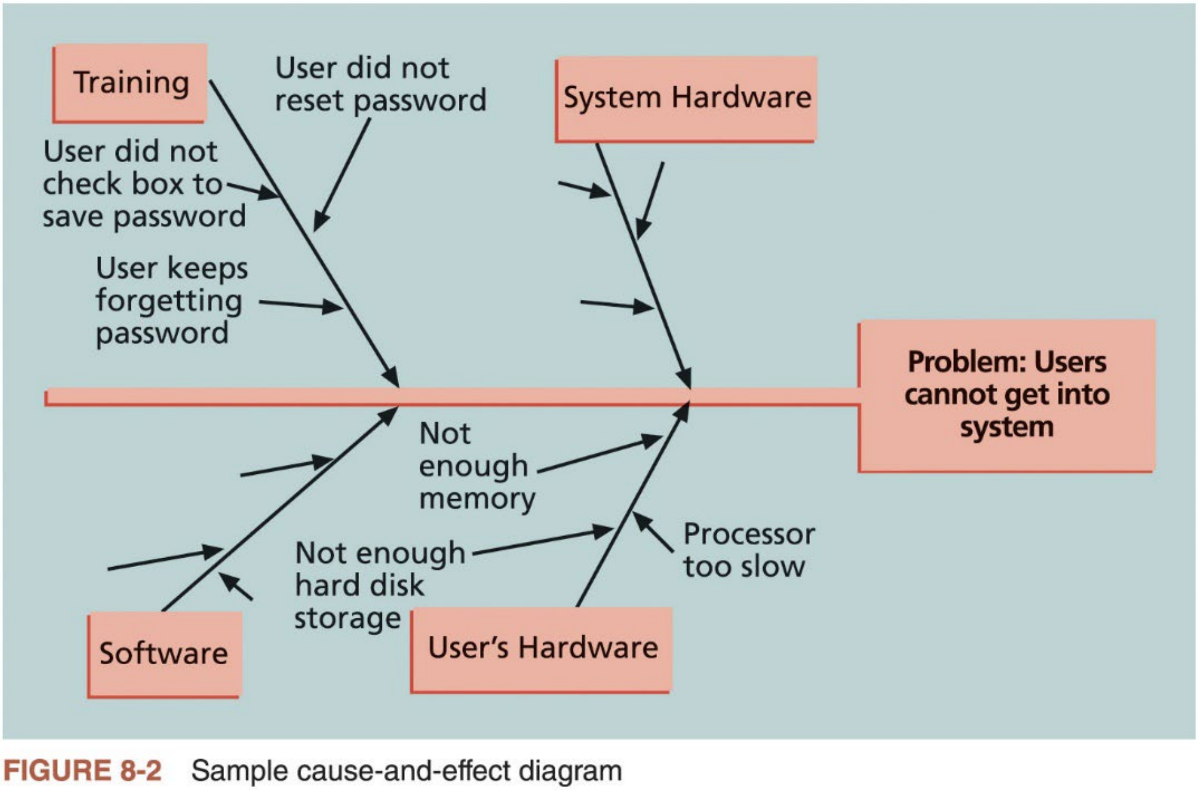
1. Cause-and-effect Diagram
n Cause-and-effect (C&E) diagrams, also known as fishbone or Ishikawa diagrams, trace complaints about quality problems back to their root cause.
Figure 8-2 shows a sample C&E diagram one might create to discover why users cannot log in to an executive information system (EIS)
15

Slide 15
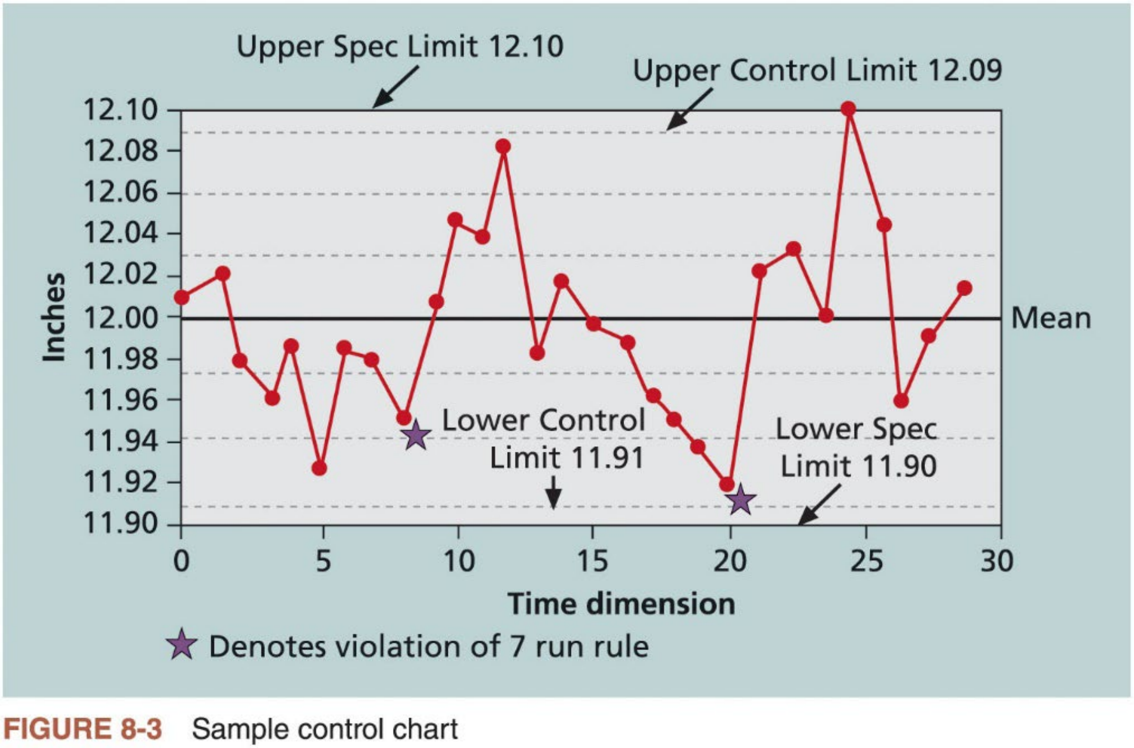
2. Control Charts
n Control chart is a graphic display of data that illustrates the results of a process over time. It allows you to determine whether a process is in
control or out of control.
Figure 8-3 shows a sample control chart for a process that manufactures 12- inch wood rulers by machines on an assembly line
16

Slide 16


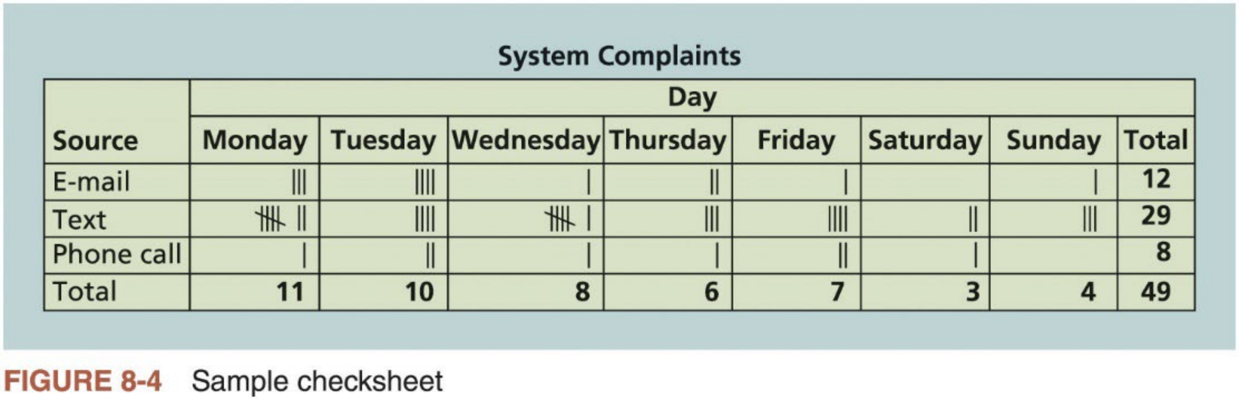
3. Check Sheets
n Check sheet, sometimes called a tally sheet or checklist, is used to collect and analyze data.
Figure 8-4 shows a sample check sheet one could use to track the media source of complaints about the EIS
It shows that most complaints arrive via text and there are more complaints on Monday and Tuesday than other days. This information might be useful in improving the process for handling complaints.
The tally marks are used to enter data occurrences manually
17

Slide 17
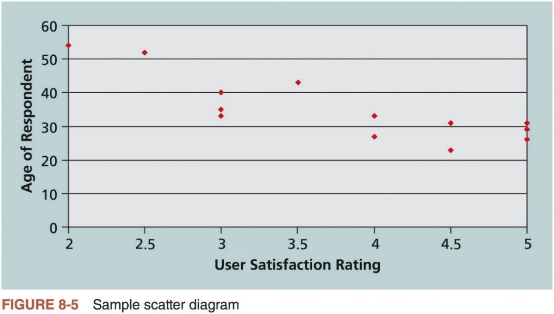
4. Scatter Diagrams
n Scatter diagram helps to show if there is a relationship between two variables. The closer the data points are to a diagonal line, the more closely the two variables are related.
Figure 8-5 shows a sample scatter diagram one might create to compare
user satisfaction ratings of the EIS system to the age of respondent to see if there is a relationship.
18

Slide 18
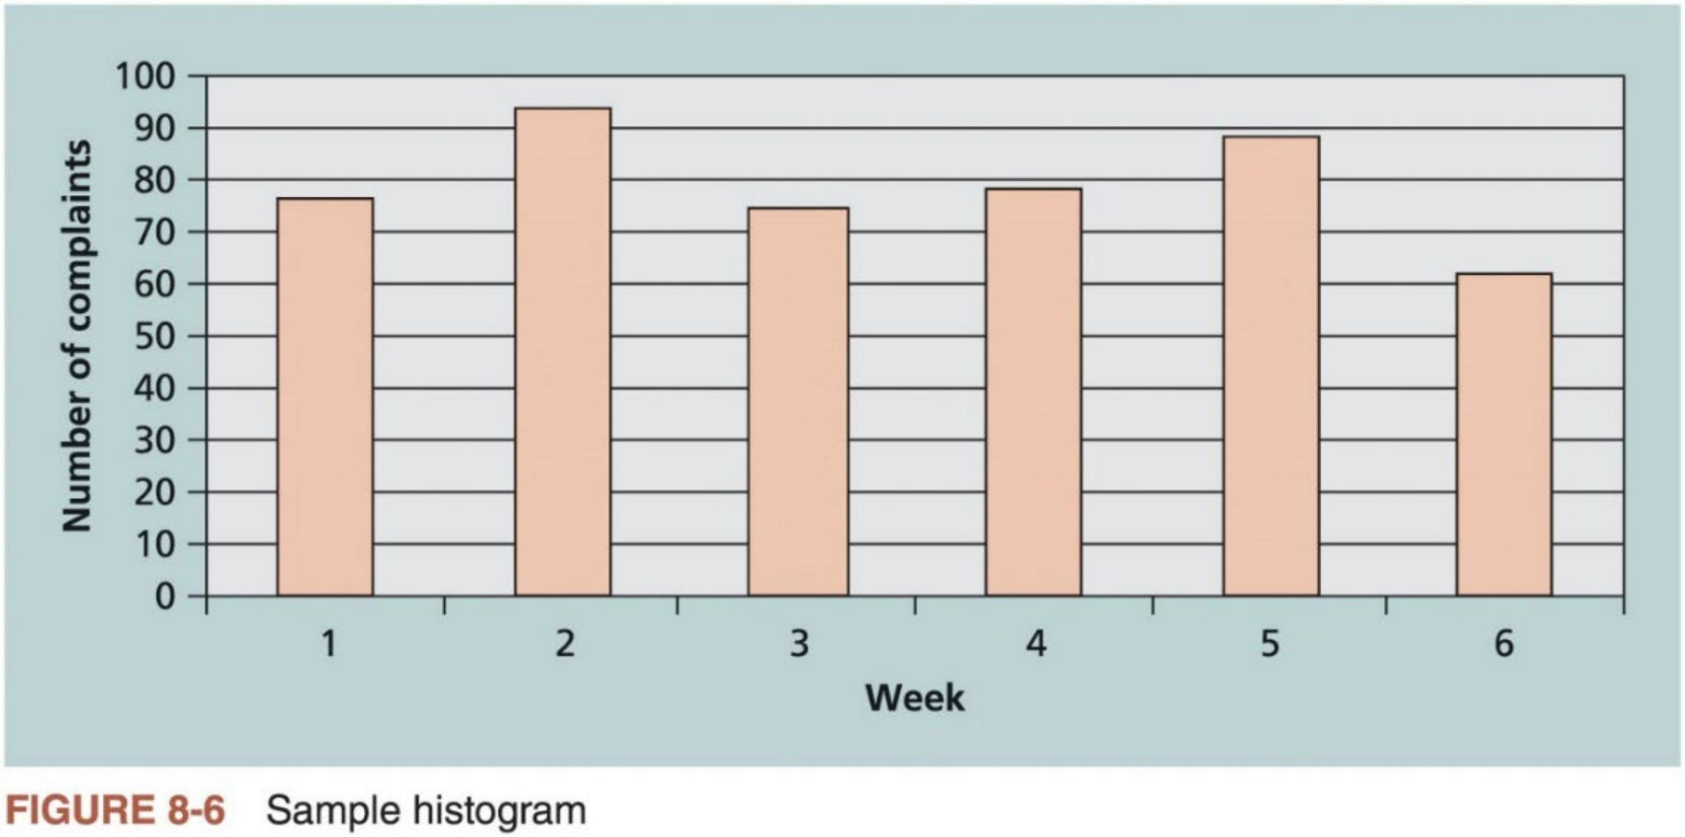
5. Histograms
n Histogram is a bar graph of a distribution of variables. Each bar
represents an attribute or characteristic of a problem or situation, and the height of the bar represents its frequency.
Figure 8-6 shows a sample histogram to graph the number of total complaints received each week about the EIS system
19

Slide 19

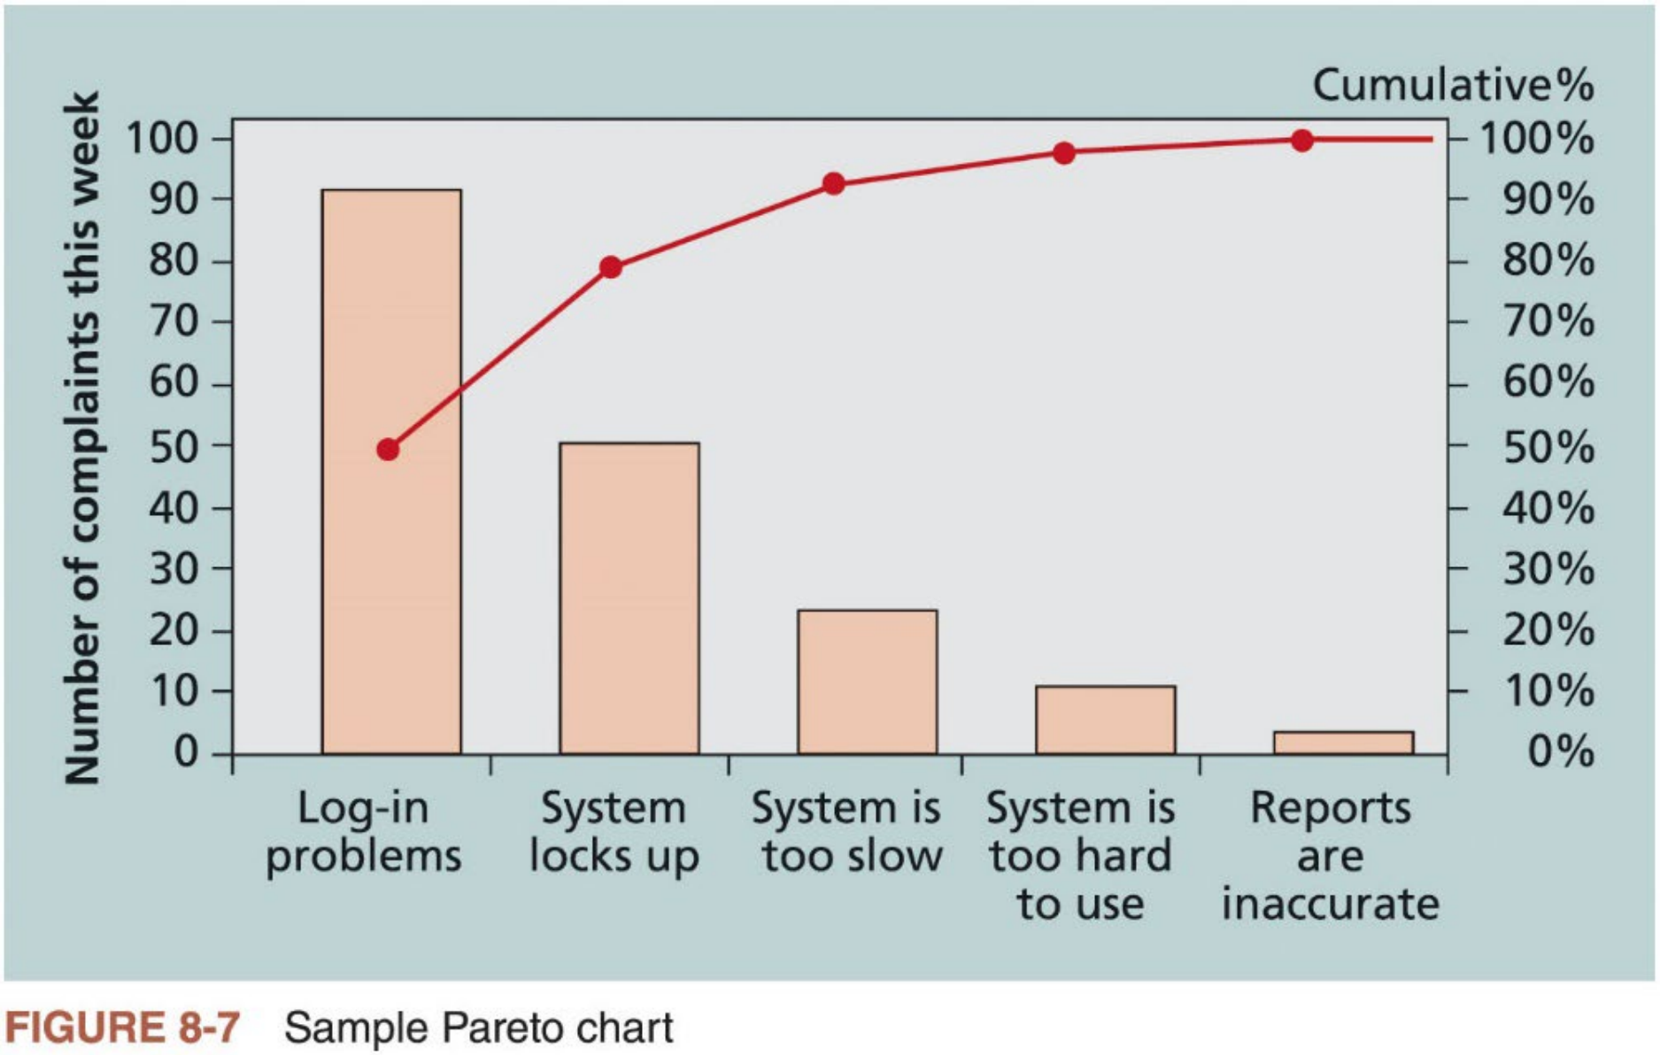
6. Pareto Charts
n Pareto chart is a histogram that can help you identify and prioritize
problem areas. The variables labeled by the histogram are ordered by frequency of occurrence.
Pareto charts help you identify the vital few contributors that account for most quality problems in a system. Pareto principle or 80-20 rule.
Figure 8-7 shows a sample pareto chart based on user complaints data
20

Slide 20
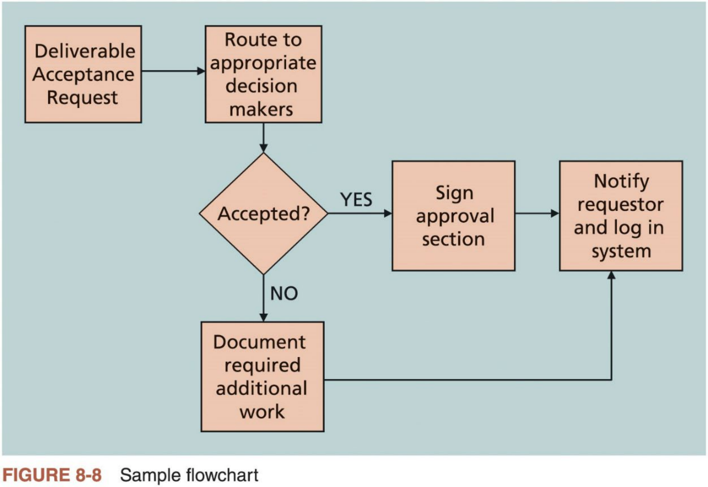
7A. Flow Charts
n Flow charts are graphical displays ofthe logic and flow of processes for analyzing how problems occur and how processes can be improved
They show activities, decision points, and the order of how information is processed. Figure 8-8 shows a sample flow chart.
ASQ calls this basic quality tool stratification, a technique that shows data from a variety of sources to see if a pattern emerges.
21

Slide 21
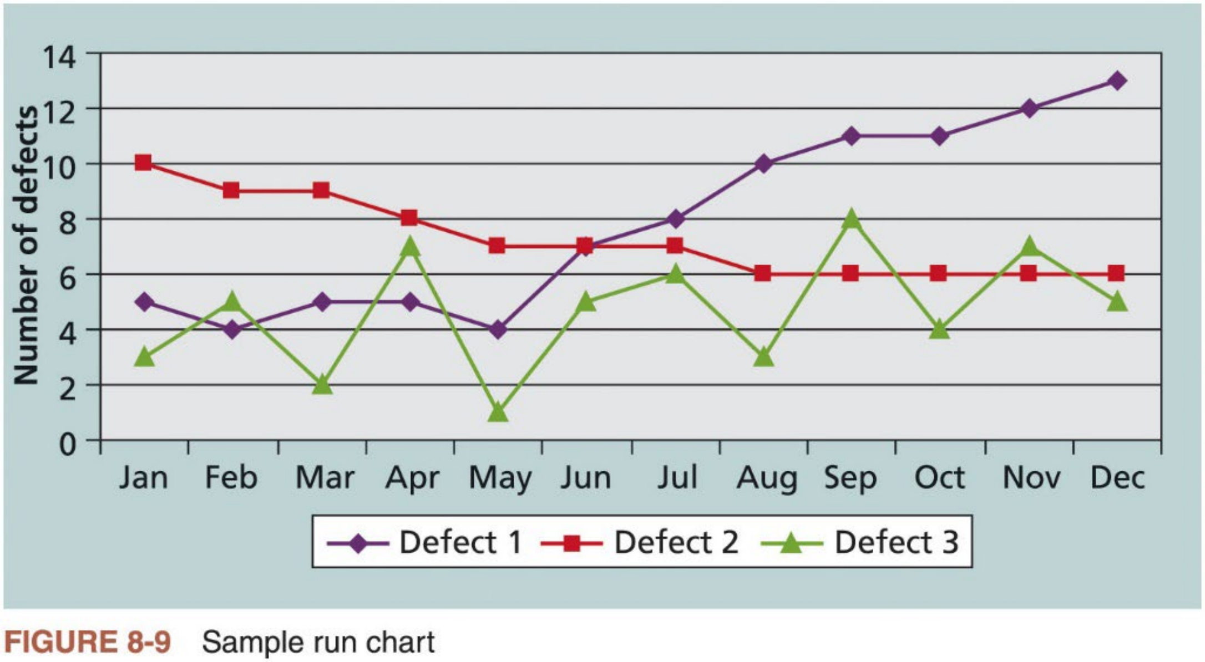
7B. Run Charts
n Run chart displays the history and pattern of variation of a process over time. It is a line chart that shows data points plotted in the order of
occurrence.
Run charts can be used to perform trend analysis and for stratification
Figure 8-9 shows a sample run chart of the numbers of defects each month for three different types of defects
22

